Slide 1
Exploring Options for Municipal Water Service
in Jenkinsville area of the Town of Queensbury
Initial Public Informational Meeting
August 2022
February 2020

Slide 2
The Queensbury Town Board is exploring potential municipal
water supply options for the Jenkinsville area.
We are in the exploratory phase. No decisions or commitments have been made.
The options considered thus far are entirely conceptual.
The Town Board wants to hear feedback from the community.
February 2020

Slide 3
The Town Board engaged engineering firm C.T. Male Associates to
assess potential options. C.T. Male has issued a draft report.
For purposes of its analysis, C.T. Male created a conceptual “district” that could include as many as 170 properties to be served.
C.T. Male identified two potential options:
  — Extension of the existing municipal water system to serve the properties
  — Establishment of a potable water supply well north of
  Route 149 between Bay Road and Ridge Road to serve them.
February 2020

Slide 4
C.T. MALE ALSO EVALUATED:
  Fire Protection: System can be built to ensure adequate fire protection, including the installation of fire hydrants.
  Water age: Standing water time in mains would not be excessive.
  System Upgrades: Would the existing town water treatment plant and related equipment be adequate to serve as many as 170 additional customers as well as current customers? Town will seek bids for further engineering analysis.
February 2020

Slide 5
ESTIMATED COSTS FOR PREMININARY OPTIONS:
  Extension of the municipal system and related system upgrades,
  with fire-flow capability. $4.6 million
  Extension and related upgrades, without fire flow capability. $4.1 million
  Establishment of potable water supply well north of Route 149,
  with the necessary water line extensions. $5.2 million
February 2020

Slide 6
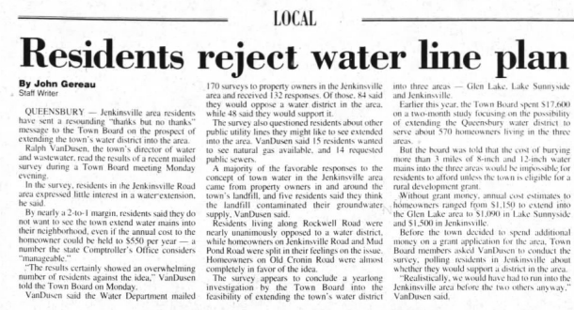
RELEVANT HISTORY
In 1999, similar project was rejected because of community opposition
based on cost
“Jenkinsville residents sent a
resounding ‘thanks but no thanks’
message to the Town Board on
the prospect of extending the
town’s water district into the area.”
The Post-Star,
Wednesday, August 18, 1999
February 2020

Slide 7
COSTS TO TAXPAYERS AND PROPERTY OWNERS
Our goal now is to assess whether there is community support for municipal water.
Knowing how many property owners would embrace public water service will help us
develop a reliable plan and cost estimates.
We will send a questionnaire to the community to seek feedback.
The Town has also engaged C.T. Male to identify possible funding sources:
  — Funding to the town for installation of mains and necessary
  additional facilities and equipment
  — Funding to possibly help defray hook-up costs for property owners
February 2020

Slide 8
NEXT STEPS
How many property owners would accept public water? How many would not?
If and where there is clear support, next step would be to explore creation of a water district map and plan and define range of costs for property owners and for the town.
We want to hear from the community. To stay abreast of this issue, visit the Jenkinsville section of town web site and sign up for emails at queensburyproject@behancom.com
We want to hear from you.
February 2020

Slide 9
QUESTIONS AND ANSWERS
  What is the likely annual cost of municipal water?
  We will be better able to provide a reliable estimate when we know how many property owners would embrace municipal water service and how much grant funding could be obtained. We may also be able to consolidate a new district, if formed, with the existing town water district, which would likely result in some additional cost savings to property owners. Our goal is to make the cost of water in the proposed district, if formed, comparable to the costs paid by other Queensbury property owners.
  Why are streets beyond the immediate Jenkinsville area included in the conceptual district?
  This was done for purposes of the draft engineering analysis. The route C.T. Male identified appears to be the most cost-effective for property owners and taxpayers. However, this is conceptual only: No district has been proposed or formed. We are exploring options and seeking community feedback.
February 2020

Slide 10
QUESTIONS AND ANSWERS (continued)
  Would all property owners in a district be forced to abandon their wells?
  The Town is not proposing to force property owners to abandon their wells if there is not a sound reason to do so. The Town and New York State have encouraged property owners whose wells showed detections of 1,4-Dioxane to discontinue the use of their wells for drinking water.
  Would all property owners in a district, if one is formed, be forced to accept and pay for municipal water?
  The Town does not force property owners to accept municipal water if they do not wish to use it. They may be required to share in the costs of the district because the existence of public water service is considered a benefit to each property that has access to it.
February 2020

Slide 11
QUESTIONS AND ANSWERS (continued)
  Why should residents of Jenkinsville have to pay anything for municipal water?
  Municipal water is considered a benefit for current and future property owners. All Queensbury property owners who have access to municipal water share in the cost. We will pursue grant funding and other cost-reduction opportunities, with the goal of seeing that residents of Jenkinsville would pay water rates comparable to those paid by other property owners in Queensbury.
  Since the town landfill presumably benefited the entire town, shouldn’t the entire town pay for municipal water for Jenkinsville?
  The source of the low levels of 1,4-Dioxane that has been detected in some wells in the Jenkinsville area has not been determined. DEC is studying this question.
February 2020

